Slide 1

PY++
PY++
PYTHON TO C++ TRANSLATOR
PYTHON TO C++ TRANSLATOR
EF ACADEMY
CODY | ERVAN | AMY

Slide 2
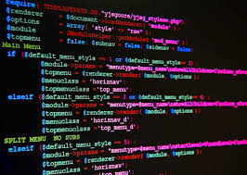
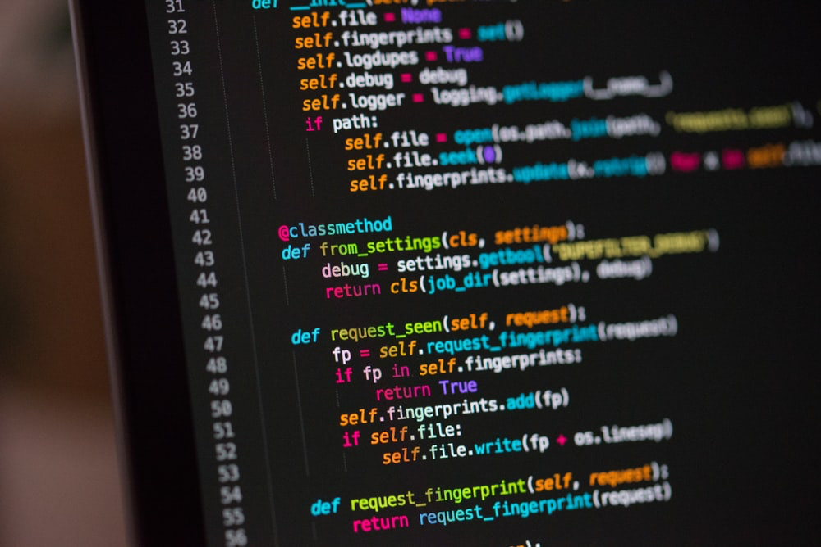
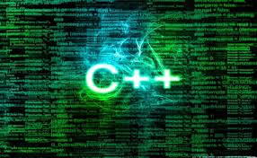
PY++
CONCEPT
PY++:
An algorithm or a program which is similar to a google translator but for programming language.
Helping people for learning different programming language easier.
Convenient for coding.

Slide 3
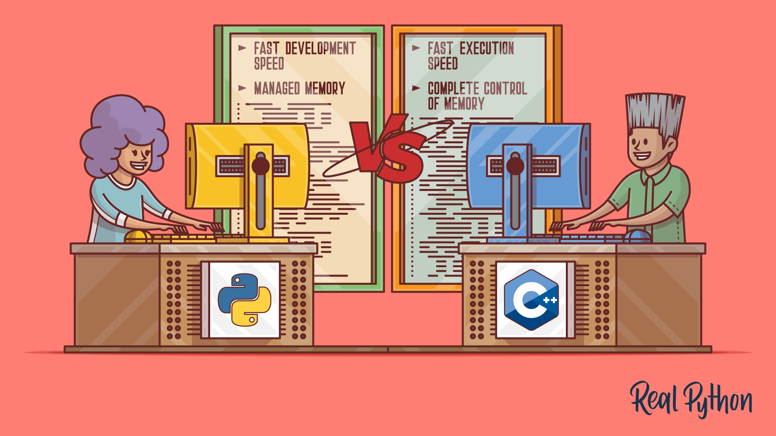
PROBLEM TO SOLVE
Nowadays, there are lots of programming languages such as Java, JavaScript, Python, C++, C#... to apply in our life but we cannot learn all of these languages.Python and C++ are in the most popular languages, therefore, we have idea to create a program which is have similar function to Google Translate but for programming language. In education, PY++ will be a tool which can help students learning the different language easier.
For example, a student who just know clearly about the C++ language and the school require to study the Python language. Therefore, PY++ will be useful to help this student can know both languages.

Slide 4
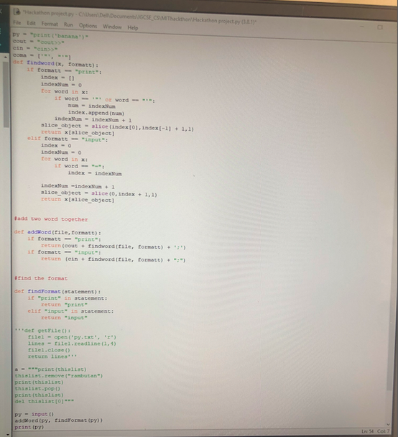
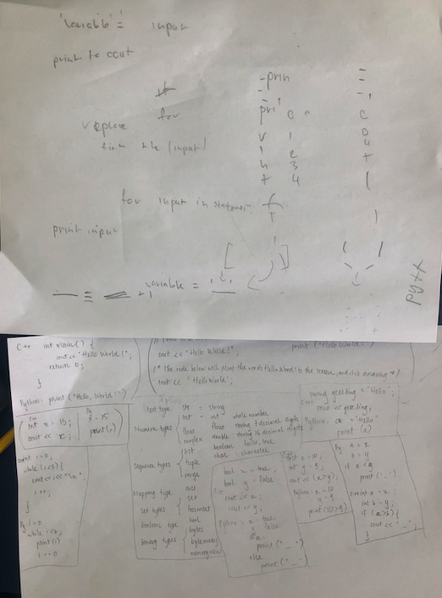
OUR WORK
Brainstorm

Slide 5
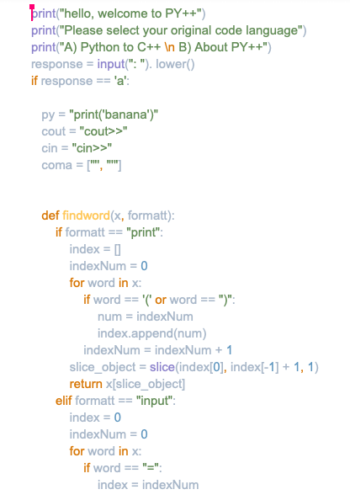
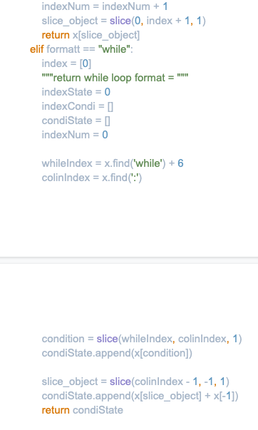
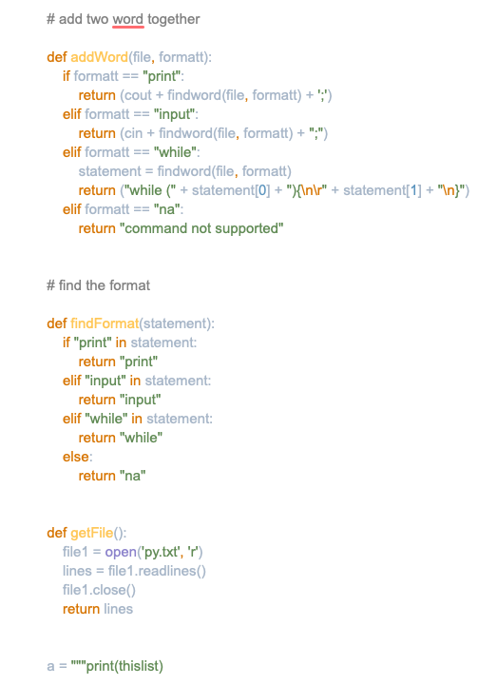
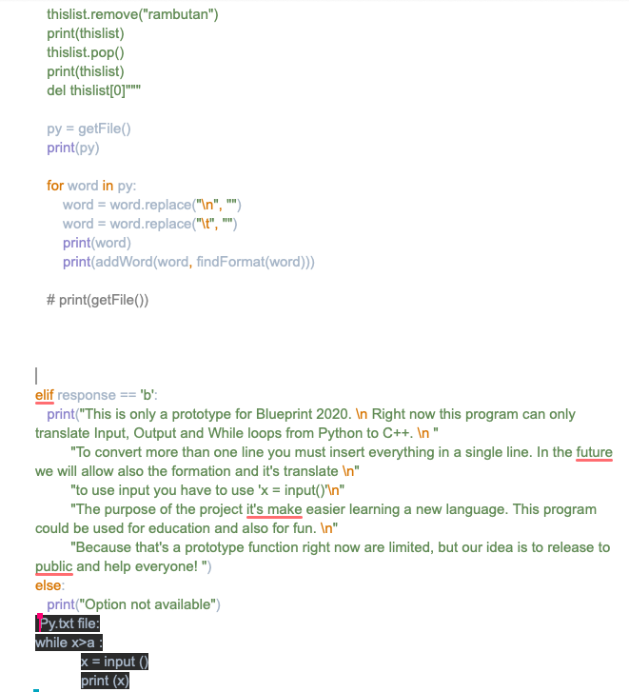
PROGRAMMING
1
2
3
4

Slide 6
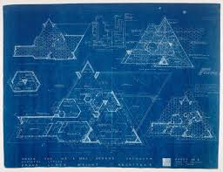
THANK YOU
THANK YOU

